Slide 1



Online Payments Fraud Detection with Machine Learning
Go
Presented by Ritwik Kumar

Slide 2



Hello Everyone!

Slide 3



Introduction
The introduction of online payment systems has helped a lot in the ease of payments. But, at the same time, it increased in payment frauds. Online payment frauds can happen with anyone using any payment system, especially while making payments using a credit card. That is why detecting online payment fraud is very important for credit card companies to ensure that the customers are not getting charged for the products and services they never paid.

Slide 4

Problem Statement
Problem Statement
Develop a machine learning model to classify fraudulent and non-fraudulent transactions.
Use a dataset from Kaggle containing historical information about fraudulent transactions to understand patterns of fraud.
Aim to assist credit card companies in early detection and prevention of fraud.
.

Slide 5

Data Collection
Dataset Source: Kaggle
Dataset Description: Historical information about online payment transactions
Key Columns:
step: Unit of time (1 step = 1 hour)
type: Type of online transaction
amount: Amount of the transaction
nameOrig: Customer initiating the transaction
oldbalanceOrg: Balance before the transaction
newbalanceOrig: Balance after the transaction
nameDest: Recipient of the transaction
oldbalanceDest: Initial balance of recipient before the transaction
newbalanceDest: New balance of recipient after the transaction
isFraud: Indicator of fraud

Slide 6


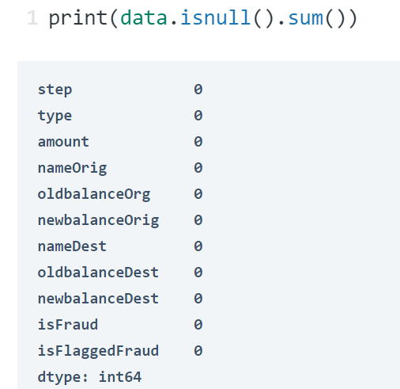

Data Preprocessing
Check for null values:
Result: No null values in the dataset.

Slide 7
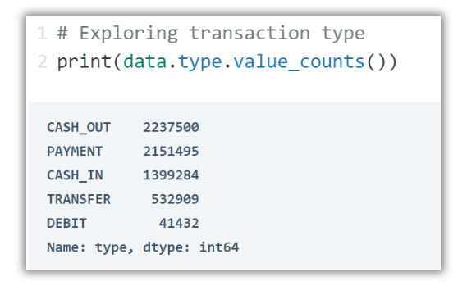
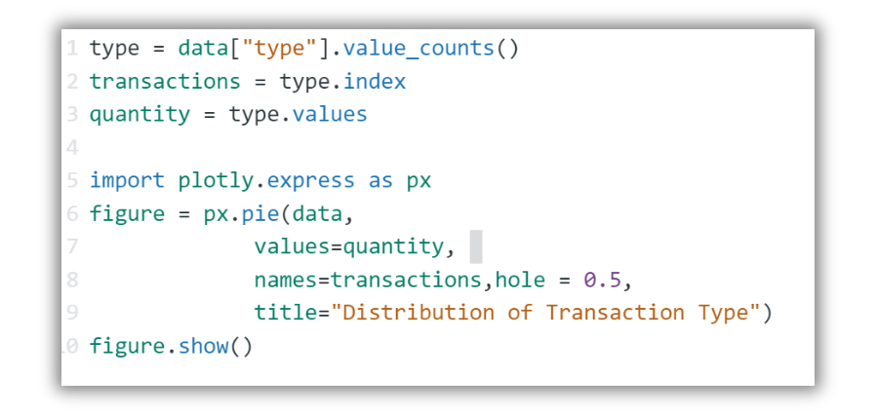
Exploratory Data Analysis (EDA)
Explore transaction types
Distribution of Transaction Types

Slide 8


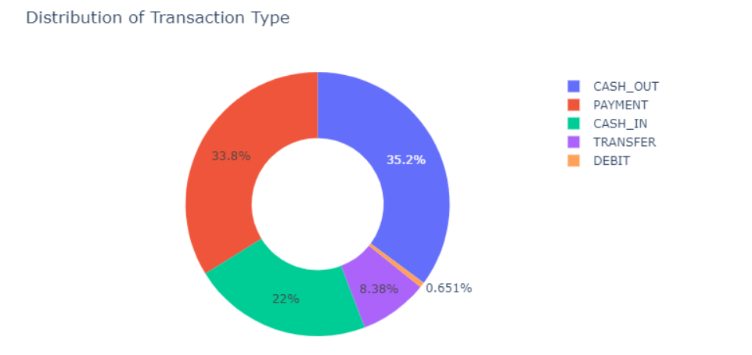
Graphs

Slide 9
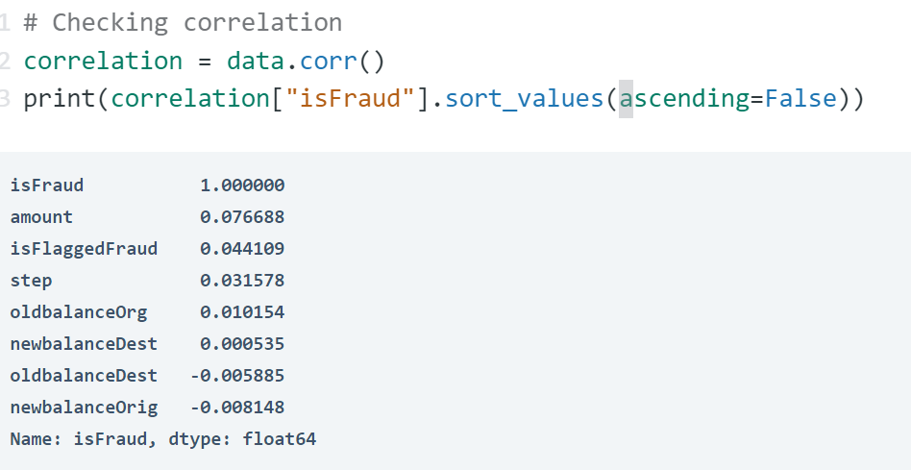
Correlation Analysis
Check correlation with 'isFraud'

Slide 10

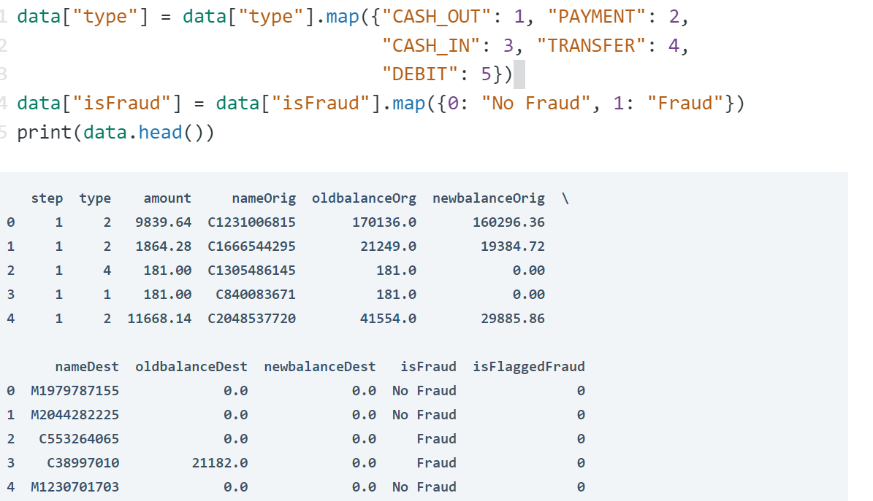
Feature Engineering

Slide 11

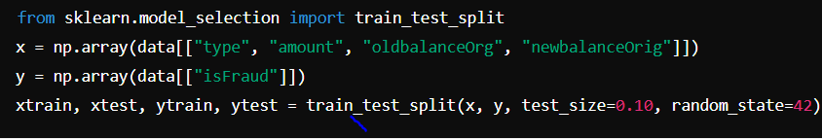
Model Training
1.
Split data into training and test sets

Slide 12
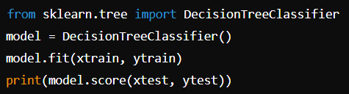
Model Training
2.
Train the model using Decision Tree Classifier:

Slide 13




Model Performance
The accuracy of the Decision Tree Classifier on the test set is:
This indicates that the model correctly classified approximately 99.97% of the transactions in the test set as either fraudulent or non-fraudulent.

Slide 14
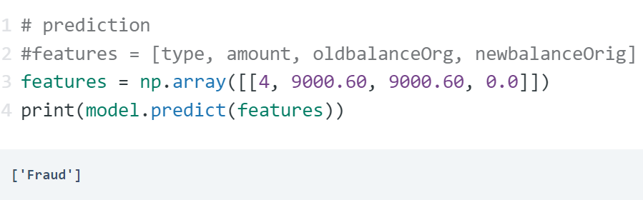
Model Prediction

Slide 15
Model Prediction

Slide 16
Conclusion
In this project, we successfully developed a machine learning model capable of detecting fraudulent online payment transactions with a high degree of accuracy (approximately 99.97%). By leveraging historical transaction data from Kaggle, we identified key patterns and features that are indicative of fraud. The implementation of a Decision Tree Classifier proved effective in distinguishing between fraudulent and non-fraudulent transactions. This model holds significant potential for aiding credit card companies and financial institutions in early fraud detection, thereby enhancing customer trust and preventing unauthorized charges. Looking ahead, future work could focus on improving the model by exploring more advanced algorithms such as ensemble methods, incorporating additional features or external data sources, and continuously retraining the model with new data to maintain its accuracy and reliability..

Slide 17
Any
Question ?
Yes
No

